Slide 1
Research Experiment
DSO-HCI Research@YDSP Project

Slide 2



Objective
Multimodal Input
= Lower Mental Workload?
(Simultaneous spacious tasks)
Game
Notes:
We are undertaking a school project called I-Focus and it is an eye-tracking project.
The objective of this research today is to conduct trial testing on 2 platforms: a game and a website, in order to test out the intuitiveness, feasibility and functionality of eye-tracking on them.

Slide 3
Overview
[Each Input Mode]
Exactly 2 Min - Training Run
Playing of Game
2-3 Min - NASA-TLX & QUIS Survey
[Total Time: ~30 min]

Slide 4

Eye-Tracker
Already Setup :)
Calibration
Glasses ok
Possible recalibration
Notes:
Before we go into the objectives for the tasks today, you will have to familiarise yourself with the eye-tracker provided.
The eye-tracker has already been setup for you, but you must perform the calibration.
All you have to do is to look at the white circles once you press “Calibrate” or “Re-calibrate”.
Depending on your calibration result, you may have to perform a re-calibration.
Glasses are ok but you may have to remove it if necessary.

Slide 5
Main Task
Play the Game!

Slide 6
Procedure (Game)
Play 3 games, and do survey (Each 5-6 min)
Eye-Tracker
Keyboard
Speech
Touch
Keyboard
(Speech)
Mouse Keyboard
- Random Order -

Slide 7
Instructions (Game)
Protect your tank from enemy tanks
Destroy them with your turret
[Control with A/D]
Shield yourself from bullets
[Control with mouse/eye-tracker/touchscreen]

Slide 8
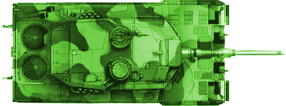
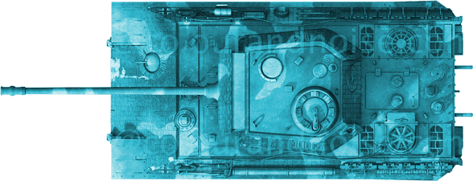
Instructions (Game)
2 types of enemies
2 types of ammo (colour-coded)
[Change ammo with W/speech]

Slide 9
Thank you
Game on! :D

